Slide 1
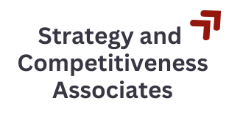
The Legacy of Michael Porter
A view from the intersection of research and practice
MOC Asia-Pacific Summer Conference
Ulaanbaatar, Mongolia
June 30, 2025
Richard Bryden
info@strat-comp.org

Slide 2



About Richard Bryden, at the intersection of research and practice
Recently retired from Harvard University where he worked with Michael Porter for 21 years, but…
Continuing work in the same fields through:
Currently teaching in the business program at Showa University Boston Institute

Slide 3
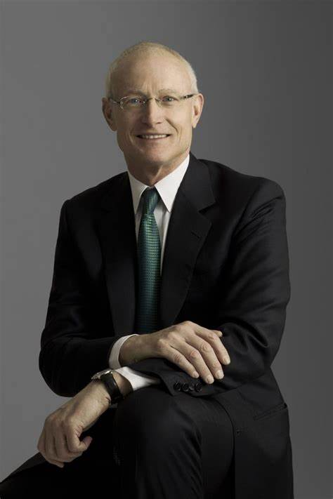
Themes from Michael Porter’s Legacy
Take on big issues: clear, accessible frameworks to formerly intractable problems
Think broadly and beyond the traditional “bottom line”
  …and drive impact – a legacy of institutions continuing Michael Porter’s work
Always challenge yourself and your organization to do better
Notes:
Very personal perspective. I am very grateful to

Slide 4
(1) Take on Big Issues

Slide 5
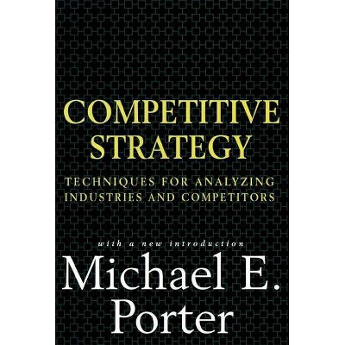
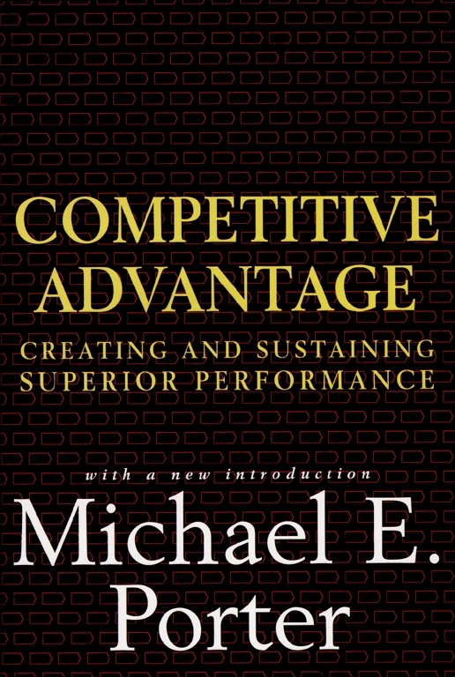
Bringing Economics to Strategy
Market Structure
(1980)
Company Positioning
(1985)

Slide 6
Determinants of Long-Term Industry Profitability
“Porter’s Five Forces”
Threat of Substitute
Products or Services
Bargaining Power
of Suppliers
Rivalry Among
Existing Competitors
Bargaining Power
of Buyers
Threat of New Entrants
© Michael E. Porter

Slide 7
Determinants of Relative Performance
Operational
Effectiveness
Strategic
Positioning
Assimilating, attaining, and extending best practice
  Creating a unique and sustainable competitive position
© Michael E. Porter

Slide 8
Legacy in Strategic Management
Radically changed the practice and teaching of strategy
Provided actionable frameworks to guide managers
Promoted a focus on a set of choices that need to be made to position a company for its customers

Slide 9
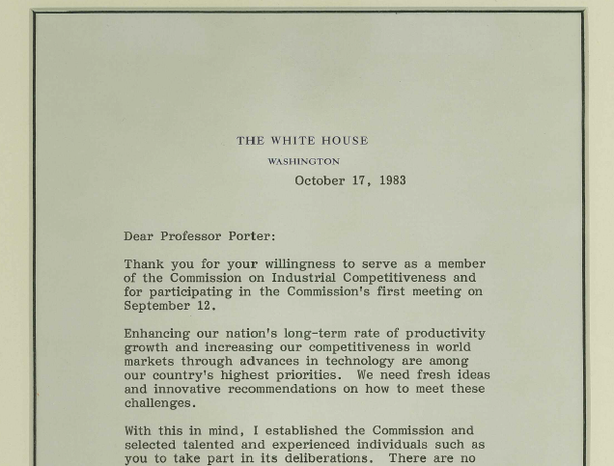
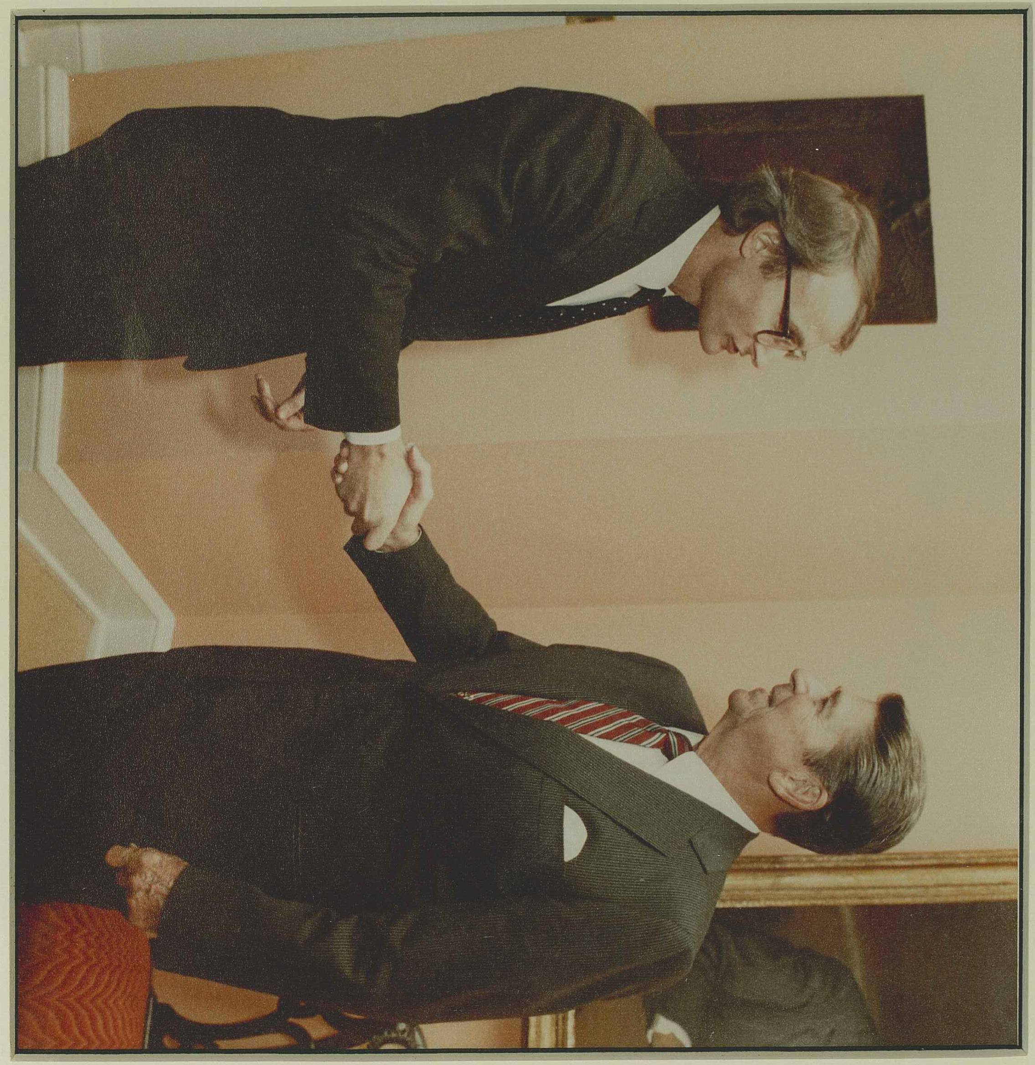
The next big challenge
Notes:
36

Slide 10
Big Questions, Big Approaches, Big Impact
Can the U.S free market system compete with more command-driven economies?
What is the role for government?
How can we make progress; what are the levers for economic development?

Slide 11
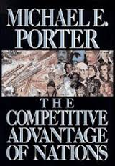
A Research Effort that Started Four Decades Ago
What drives differences in economic performance across locations?
  Role of location in competition
Why do leading companies in specific industries concentrate in a small number of places?
  How do clusters matter?
How can nations, states, and regions achieve sustainable improvements in economic performance?
(1990)
Notes:
800 pages
Put the current work into the context of a larger research ambition that has been developing over the last 25-30 years.
Maybe comment quickly on how you got from your work on company strategy and industry structure to study competitiveness and clusters

Slide 12

A personal favorite
Can the U.S free market system compete with more command-driven economies?
What is the role for government?
(2000)

Slide 13
(2) Think Broadly

Slide 14
Where next?
What is the role of business in society?
“Creating Share Value” (2011)
Shared value holds the key to unlocking the next wave of business innovation and growth. It will also reconnect company success and community success in ways that have been lost in an age of narrow management approaches*, short-term thinking, and deepening divides among society’s institutions.
Shared value opens up new needs, new markets, new value chain configurations, and new ways of thinking about the business. This creates new opportunities for strategic positioning and new competitive advantages. When companies incorporate a social dimension into their value proposition, they tap into the potential for a competitive advantage that is more sustainable versus competitors than conventional cost and quality advantages.
*Milton Friedman's 1970 article “The Social Responsibility of Business Is to Increase Its Profits” is likely one of the most assigned, and most debated, papers in social issues pedagogy.
Source: FRIEDMAN’S “THE SOCIAL RESPONSIBILITY OF BUSINESS IS TO INCREASE ITS PROFITS”: A CRITIQUE FOR THE CLASSROOM, Craig P. Dunn and Brian K. Burton

Slide 15

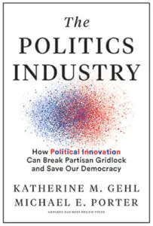
Redefining entire industries to tackle societal issues
Why does the health care system struggle to deliver value to patients?
Redefining Health Care
An in-depth proposal gaining broad traction to organize care around medical conditions, measure outcomes, and align reimbursement with value delivered.
Our American political system is broken. (How do we fix it?)
The Politics Industry
Applies the tools of business analysis to show how the political system functions just as every other competitive industry does, and how the duopoly has led to the devastating outcomes we see today. Using this competition lens, Gehl and Porter identify the most powerful lever for change—a strategy comprised of a clear set of choices in two key areas: how our elections work and how we make our laws.
(2006)
(2020)

Slide 16
Legacy of Institutions

Slide 17





Organizations founded, funded, and directed by Michael Porter
ICIC drives inclusive economic prosperity in under-resourced communities through innovative research and programs to create jobs, income, and wealth for local residents. Vision: To eliminate concentrated poverty and close the racial wealth gap in the United States.
At the Social Progress Imperative, our mission is clear: to translate data into solutions that advance social progress across the world. We're committed to providing evidence-based insights and tools…
Our mission: To unlock the potential of value-based healthcare by defining global Sets of Patient-Centered Outcome Measures that matter most to patients and driving adoption and reporting of these measures worldwide to create better value for all stakeholders.
FSG is a global nonprofit consulting firm that partners with foundations and corporations to create equitable systems change. Through customized consulting services, innovative thought leadership, and learning communities, we’re working to create a world where everyone can live up to their full potential.

Slide 18
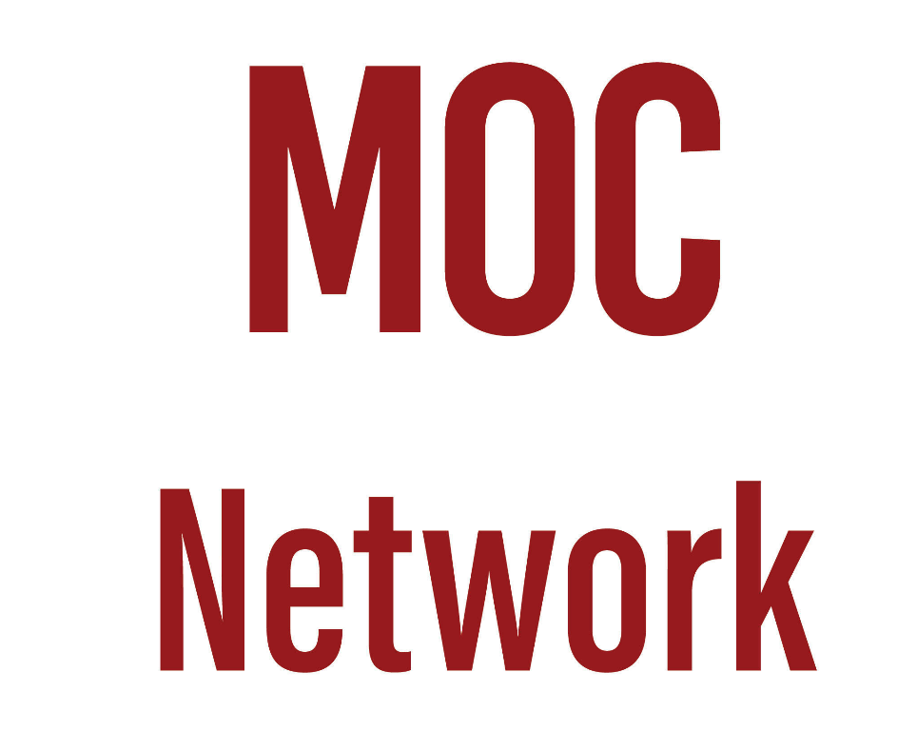
Organizations founded, funded, and directed by Michael Porter
The Microeconomics of Competitiveness (MOC) Network is a global collaborative network of universities, business schools, research institutes, competitiveness centers, and strategic partners. We are a community of scholars, and leaders in strategic development projects, focusing on addressing today’s global, regional, national, and local challenges through improving competitiveness. www.mocnetwork.org
A consultancy specializing in developing and implementing strategies that create shared prosperity, ensuring that every solution we provide not only generates economic value for our clients, but also improves the business environment, and addresses the environmental and societal challenges encountered in the communities in which they serve.
RELAUNCHING LATER THIS SUMMER: The U.S. Cluster Mapping Project aims to strengthen U.S. competitiveness by helping clusters and regions understand and improve their economic composition and performance. While much national economic debate has focused on macroeconomic challenges, most of the critical drivers of U.S. competitiveness are regional, and clusters are a central part of this framework. To fuel this region-based effort, the U.S. Cluster Mapping website offers statistical and visual data that assess business environment characteristics and showcases current reports and studies that highlight effective economic development strategies.

Slide 19
One missing…
  A Porter Institute
  Christian Ketels (leader and board member at TCI and MOC) is working with Michael Porter’s family and other sponsors to establish an independent “Porter Institute” to carry on the central organizing role to Michael Porter’s legacy that was once served by the Institute for Strategy & Competitiveness at Harvard.

Slide 20
(3) Always Challenge Yourself

Slide 21
The Challenges Ahead
It should be clear that Michael Porter continuously pushed himself to take on the next, bigger challenge. He was relentless with himself.
He challenged his students, his staff, CEOs and other leaders, and his own institutions to relentlessly think deeper, think bigger, do more.
In 2008 when Michael Porter visited Mongolia,
  he recognized progress to a market economy and to WTO membership, but
  he also challenged Mongolia to continue to develop a competitiveness-driven economy, develop the sophistication of the business sector, and expand the range and value of exports.
  Recent success indicates that Mongolia has successfully pursued that challenge, more tomorrow!

